Slide 1
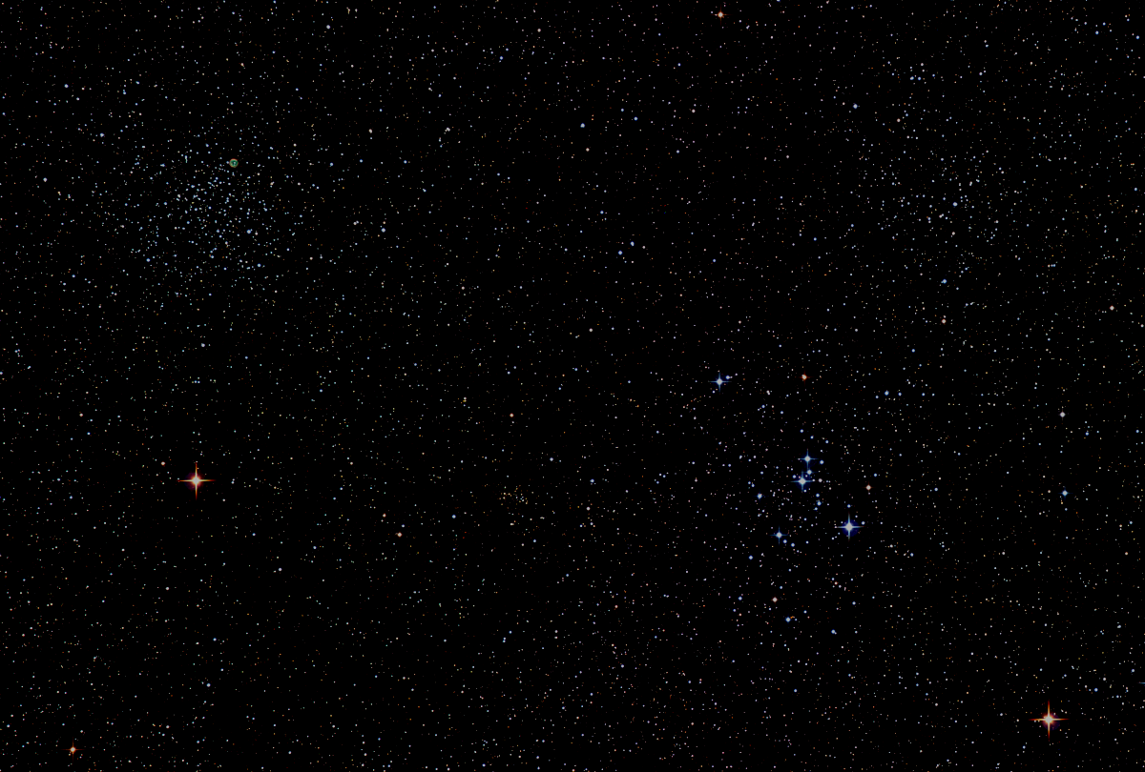

The Howard
Astronomical
League
General Meeting
17
January 18, 2018
Notes:
Howard Astronomical League, Oct 19, 2017

Slide 2
Introductions

Slide 3
Upcoming Events
HAL Events
March 17th at 7:15pm– Members’ Star Party, Alpha Ridge
March 24th at 7:30pm – Public Star Party, Alpha Ridge
Regional Events
Feb 12-18 – Winter Star Party, Florida Keys

Slide 4
HAL Business Tonight 1. Treasurer’s Report 2. Observatory Report 3. Election of 2018 HAL Officers (End of meeting)

Slide 5
HAL 2017 Financial Summary
2017 Starting Bank Balance: $7,629
2017 Income
Memberships: $5,040
Equipmt sale: $1,140
Other: $398
2017 Cash added to Bank: $6,578
2017 Expenses
Recurring: $2,160 (Note 1)
Non-recurring: $2,693 (Note 2)
2017 Cash spent from Bank: $4,853
2017 Ending Bank Balance: $9,354
Note 1: AL, Insurance, Website, Mailbox
Note 2: Materials and supplies needed to keep HALO operating and in good condition
HAL Membership Stats
12/31/15: 234
12/31/16: 219
12/31/17: 263

Slide 6
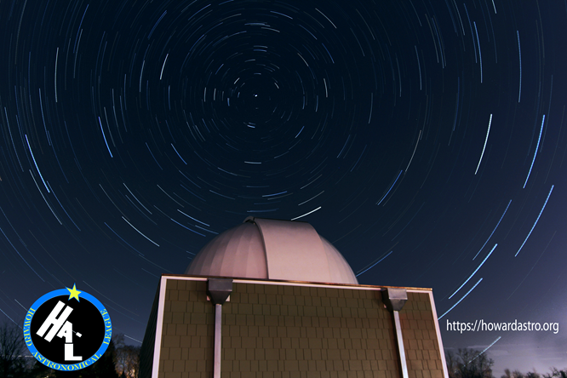
Howard Astronomical League
Observatory Update
Notes:
Howard Astronomical League, Oct 19, 2017

Slide 7
2017Alpha Ridge Events
10 Public Star Parties
9 Members Only Star Parties
(Only 2 of 9 not clouded out!)
Solarfest w/ HCR&P

Slide 8
2017 Key Purchases
QHY5III290C Webcam for Planetary Use to supplement Mallincam Universe
Upgraded pier to desk wiring from USB2 – USB3. Needed for QHY. Increases frame rate.
Purchased new Dell Laptop. USB3 port added plus.
Purchased new wheels/tires for 16” Meade wagon
Purchased steel shelving to organize storage area
Purchased new door flier box. Kept stocked.
Purchased “recycle” boxes and signage for Solar System Walk

Slide 9
Behind the Scenes
Trained a couple new CTOs, but lost just as many. Still need more.
Starting research to automate scope
Easier to use for CTOs
Better CTO retention
Show more objects, more quickly to attendees
Support member observations
Need to remove & weigh Watson OTA soon

Slide 10
HAL Library - Still to Come
HAL’s original charter calls for building an observatory (done) and a library (in progress)
Have books – some in HALO, some in other locations, books are on-line, with check-out tools in place
Check library contents here: https://www.howardastro.org/library/memprintlib.php
Still need to build book shelf storage in HALO, inventory books, complete parts of process, and then roll-out to members.

Slide 11
Astronomically Interesting
January 31st: Eclipsed super blue moon – we only see the beginning as the moon sets that morning before totality is reached
March 18th:
- Interior planets visible in the evening sky at sunset
- Exterior planets visible in the morning before sunrise

Slide 12
Guest Speaker
Dr. Avi Mandell
NASA Goddard Space Flight Center
Planetary Systems Labratory
Hot Jupiters and Lava Planets: Exploring the Diversity of Exoplanet Environments
Notes:
Lou Mayo is a planetary astronomer at the NASA Goddard Space Flight Center. Lou Mayo with over 20 years experience in program management, supporting NASA and NOAA, including over 10 years managing efforts for the NASA National Space Science Data Center and the Space Physics Data Facility. He has over 20 years experience in planetary research working on special problems concerning planetary atmospheres. He served for 11 years on the Voyager IRIS and Cassini CIRS teams. He has over 15 years experience developing and implementing space science education programs on both regional and national levels and is a professor of astronomy at Marymount University and member of the DC Space Grant Consortium. He has authored numerous articles on astronomy and astronomy education and is a frequent speaker on space science and astronomy for the public. He is presently Program Manager for NASA's 2017 Eclipse Science Education Program and Heliophysics Education Consortium and professor of astronomy at Marymount University.

Slide 13
Member’s Astrophotos
and Sketches

Slide 14
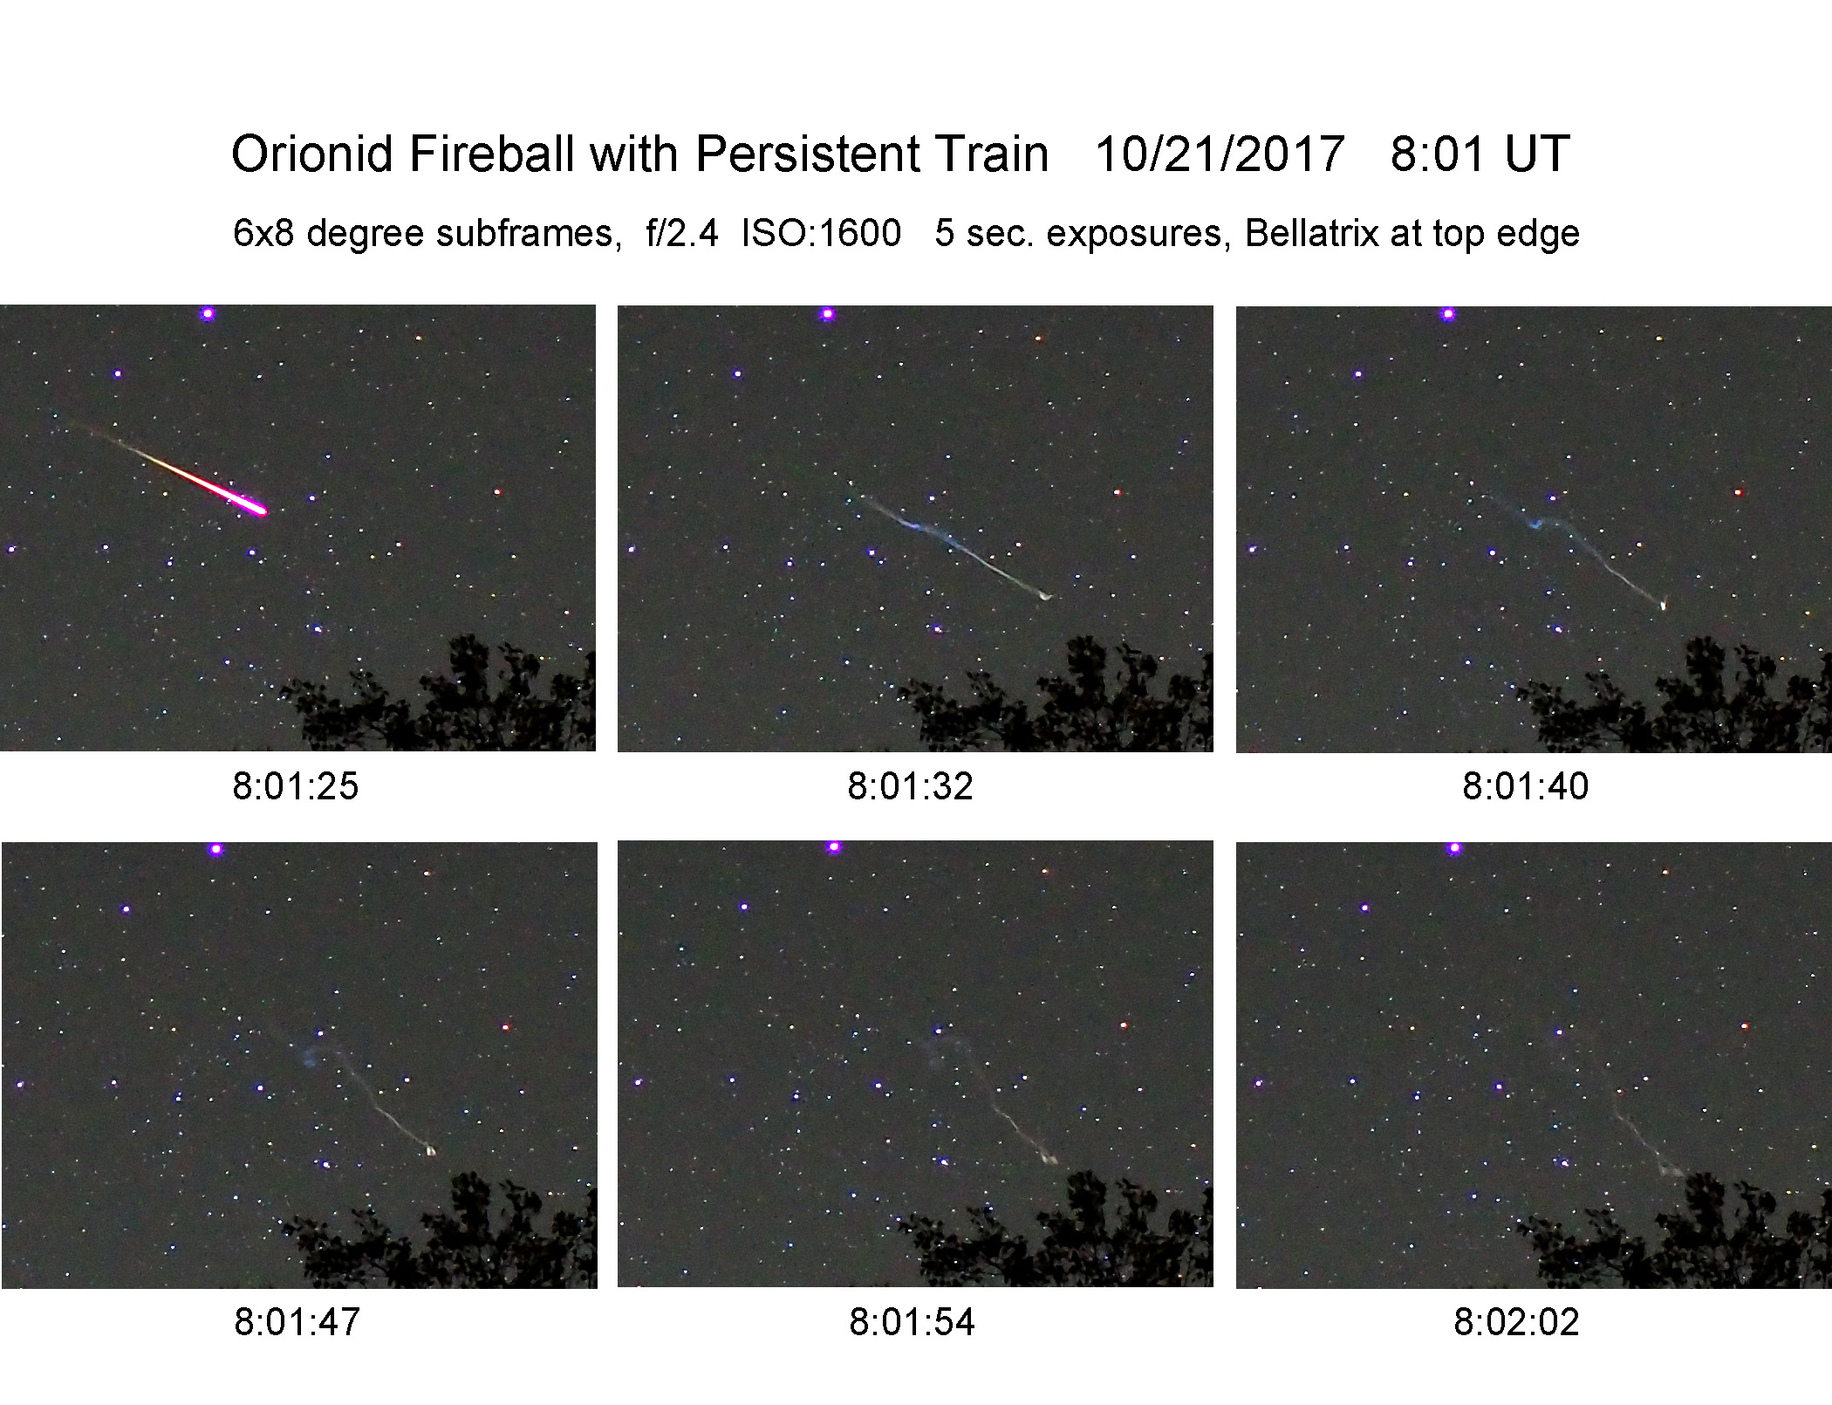
Gary Frishkorn

Slide 15
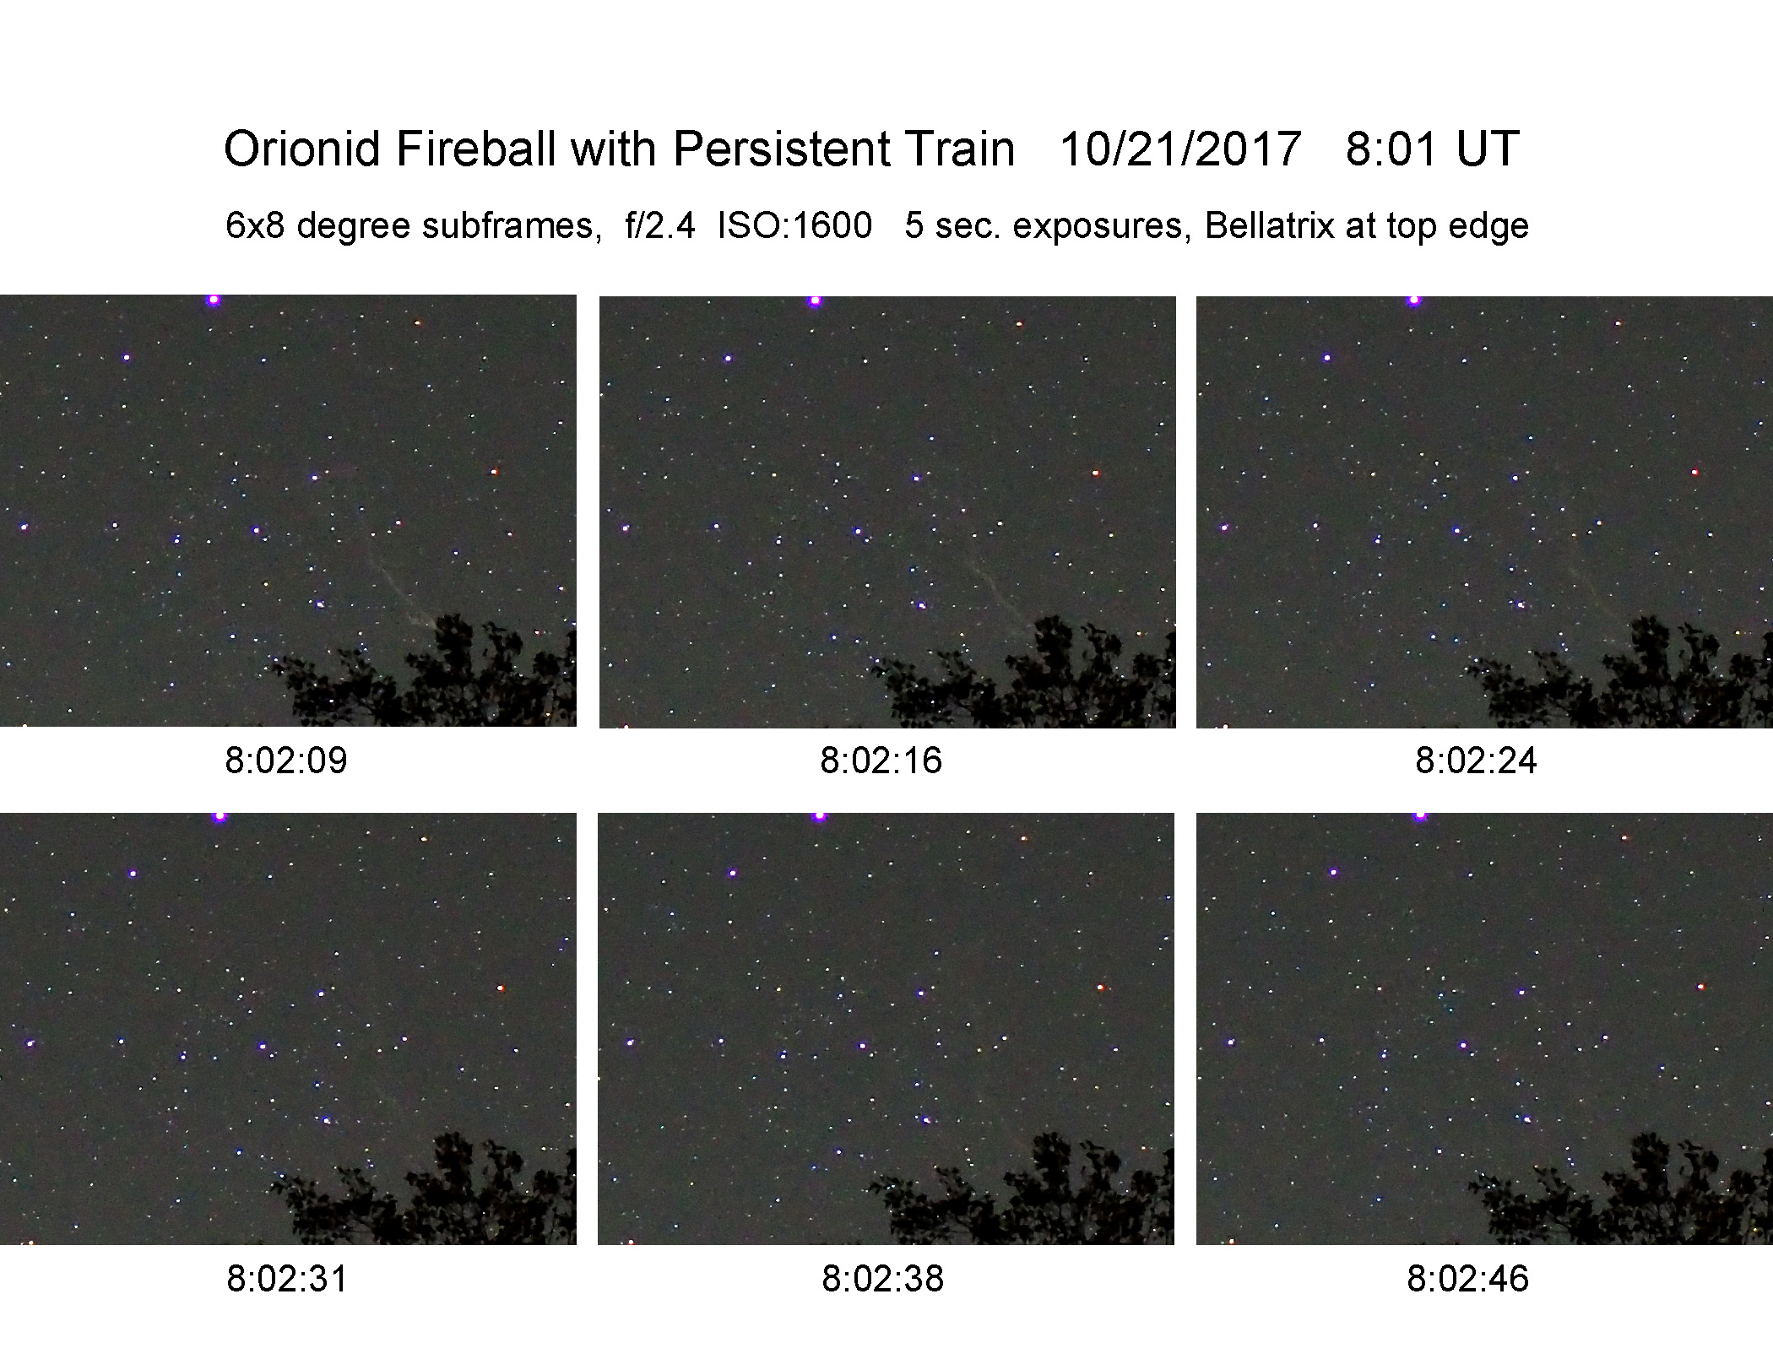

Slide 16
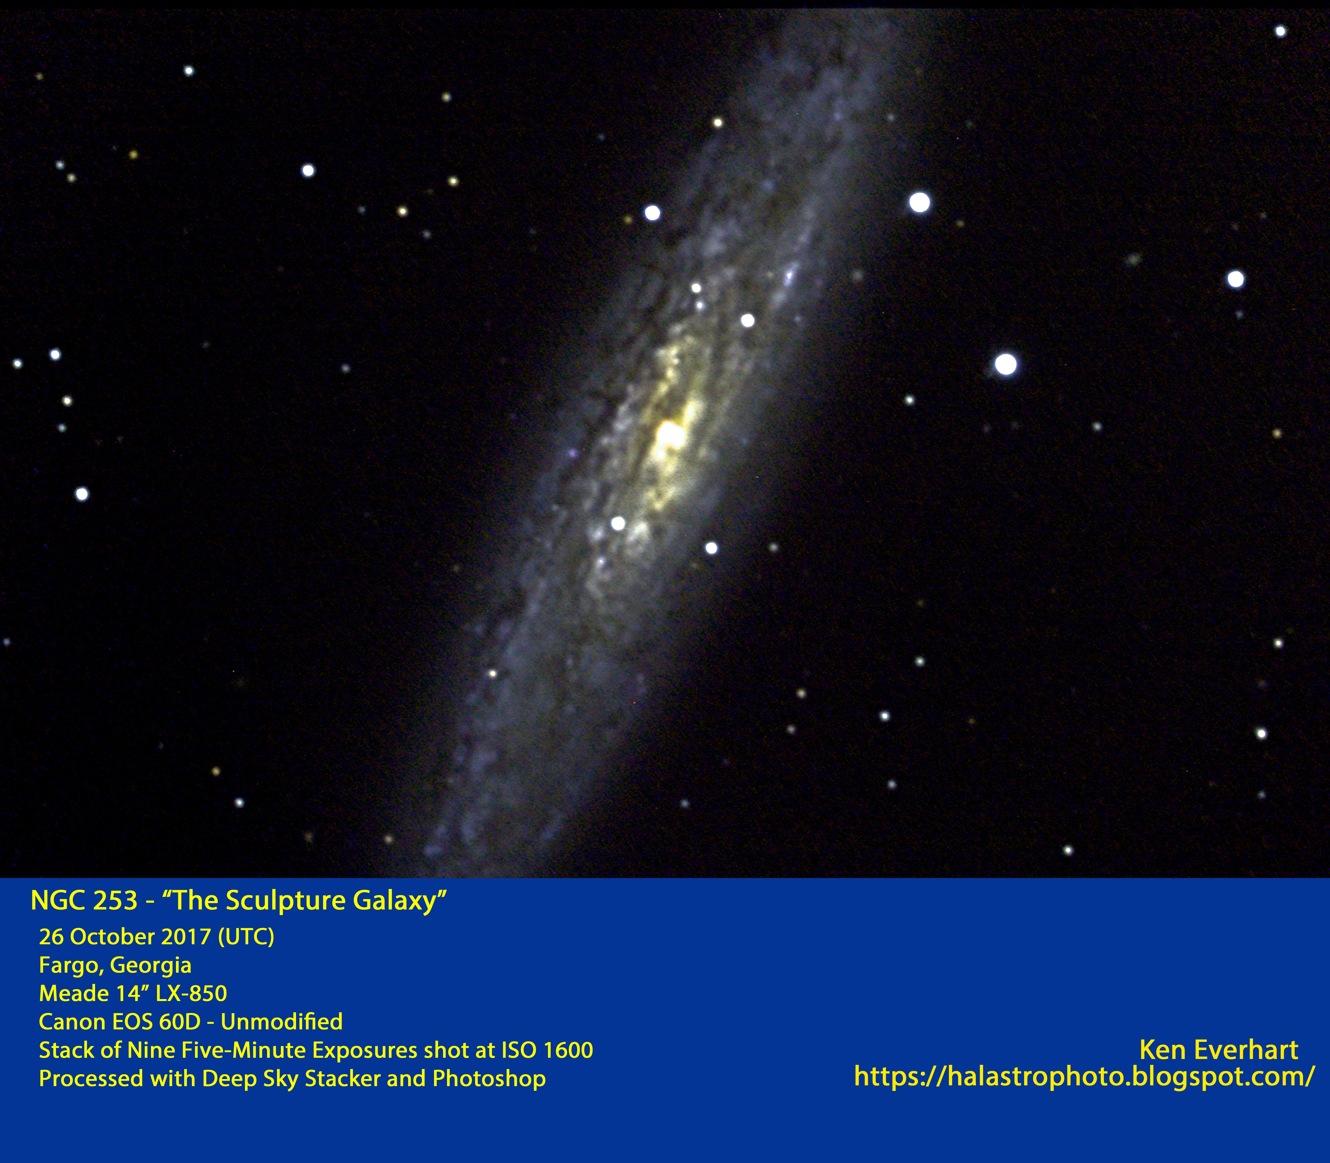
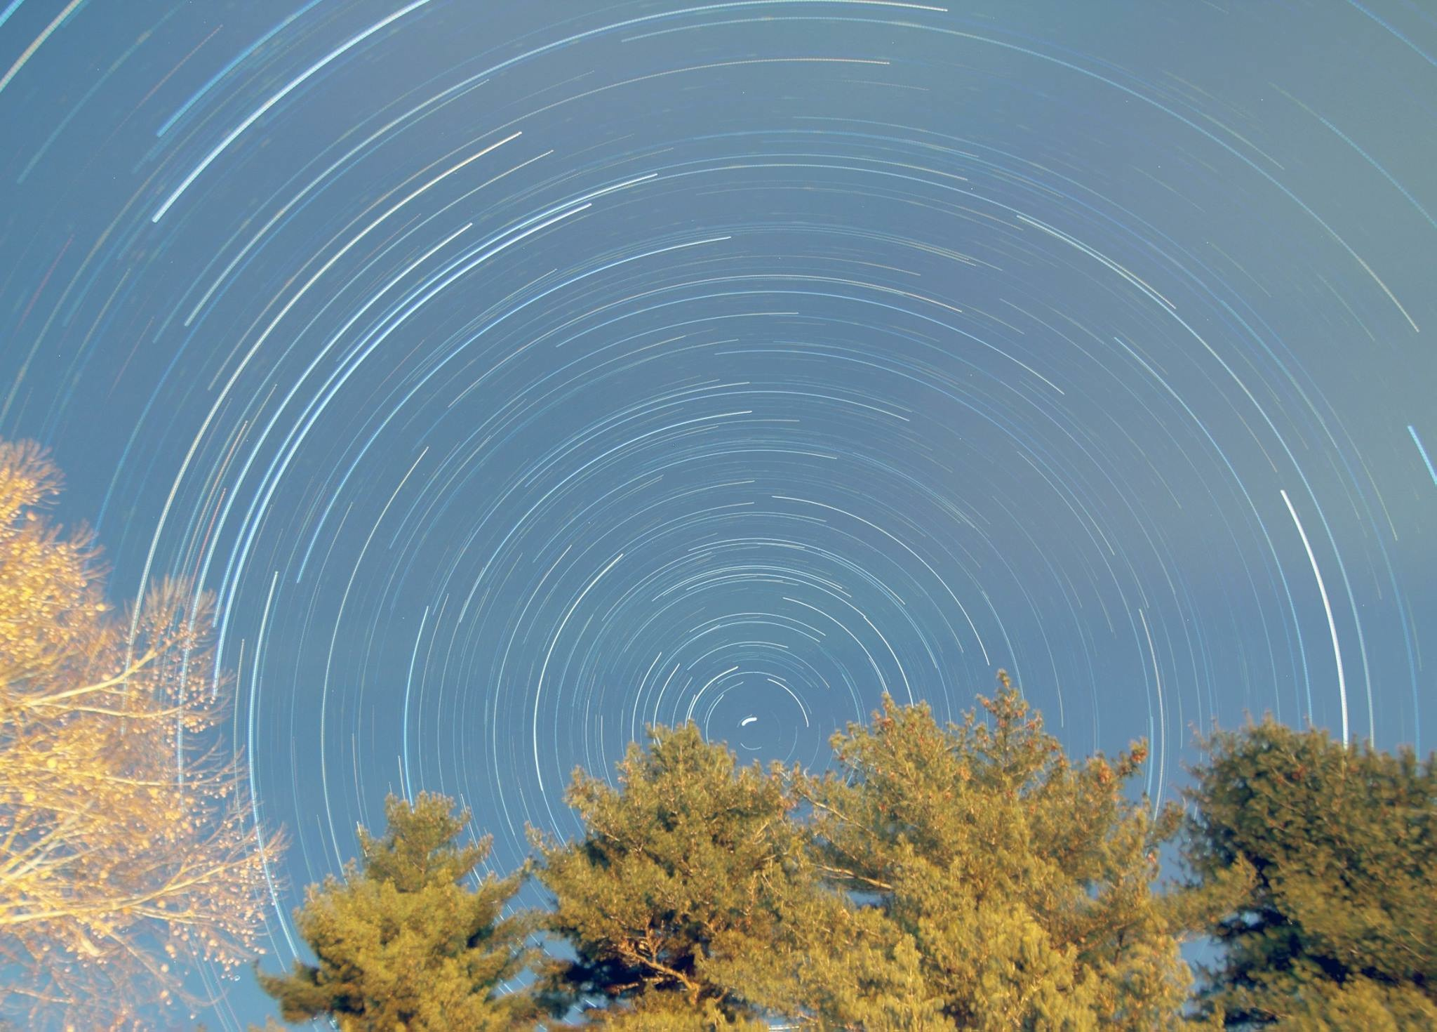
Joe Bohanon, Star Trails
(Image spanning two years)

Slide 17
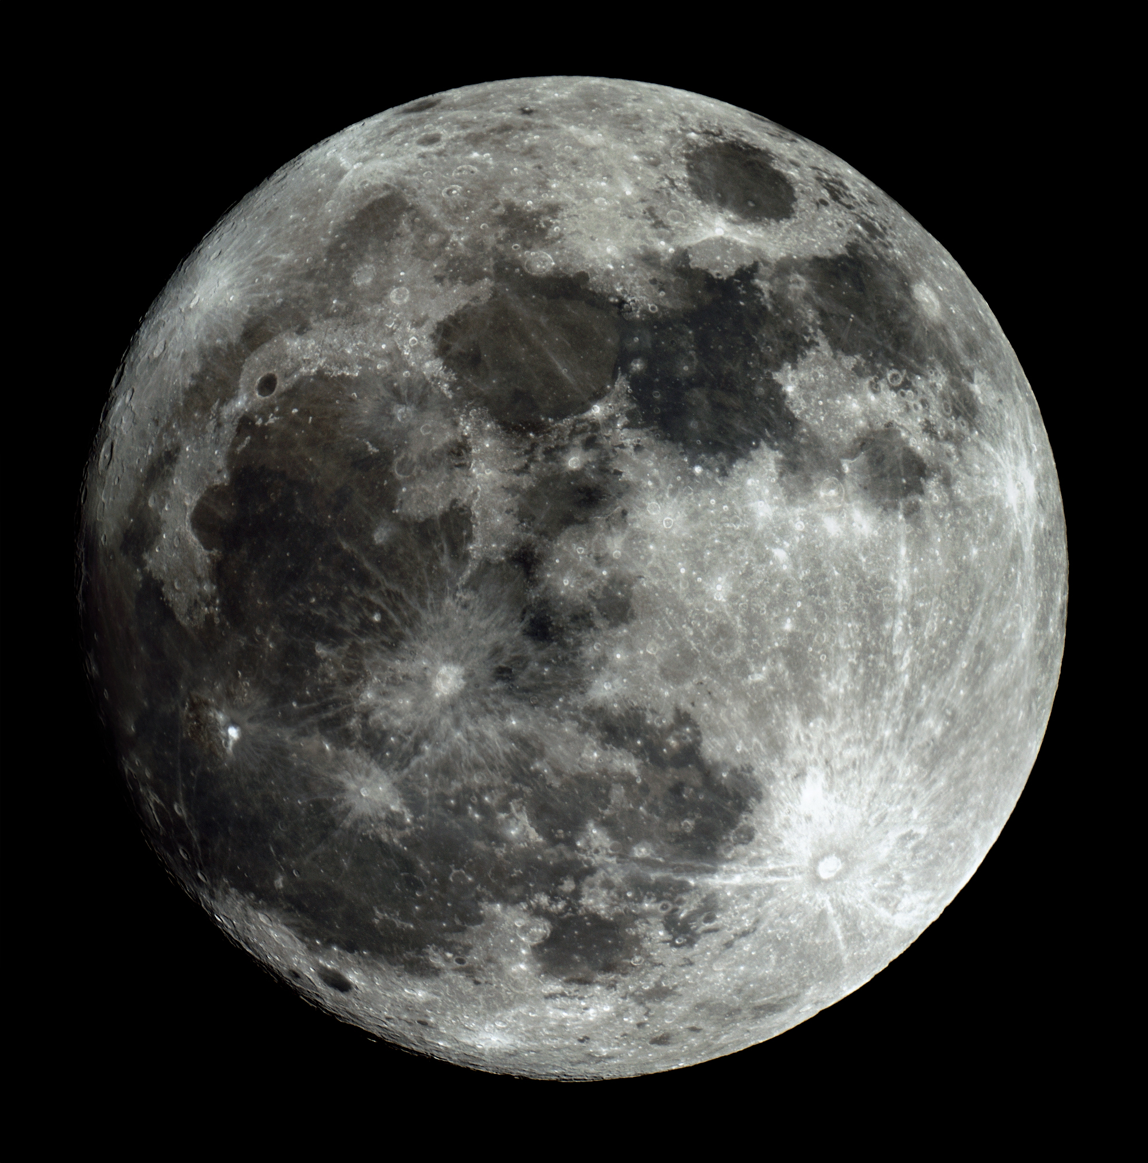
Matt Krutar
HAL Public Star Party
December 2nd, 2017

Slide 18
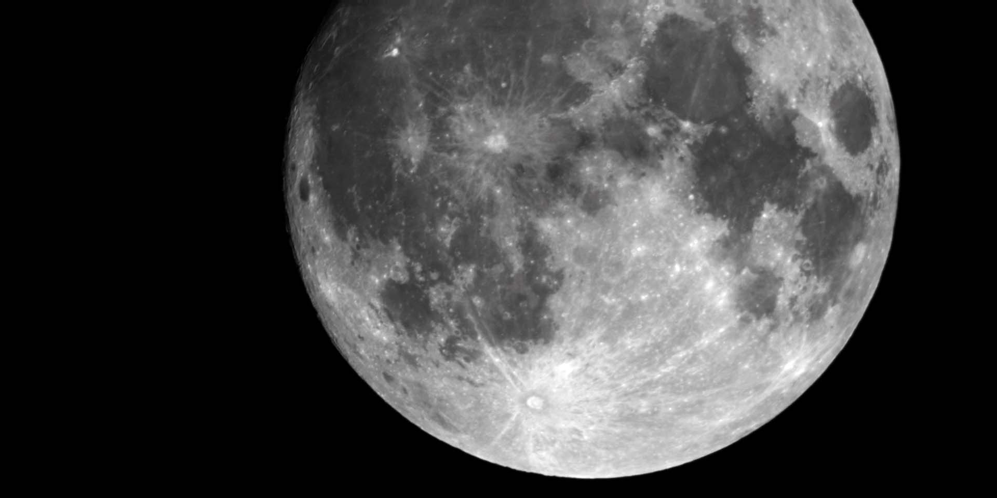
Super Moon
HAL Public Star Party, 02 Dec 2017
Watson Telescope, Mallincam Universe
David Stein and Jim Johnson

Slide 19
“Glory”
A photo by Herman Heyn during a flight from St. Louis to Baltimore
The Weather Book, Jack Williams, Vintage Books (1997)

Slide 20
Joel Goodman slides used to promote HAL at the American Astronomical Society’s APOD presentation on January 9, 2018

Slide 21


Slide 22
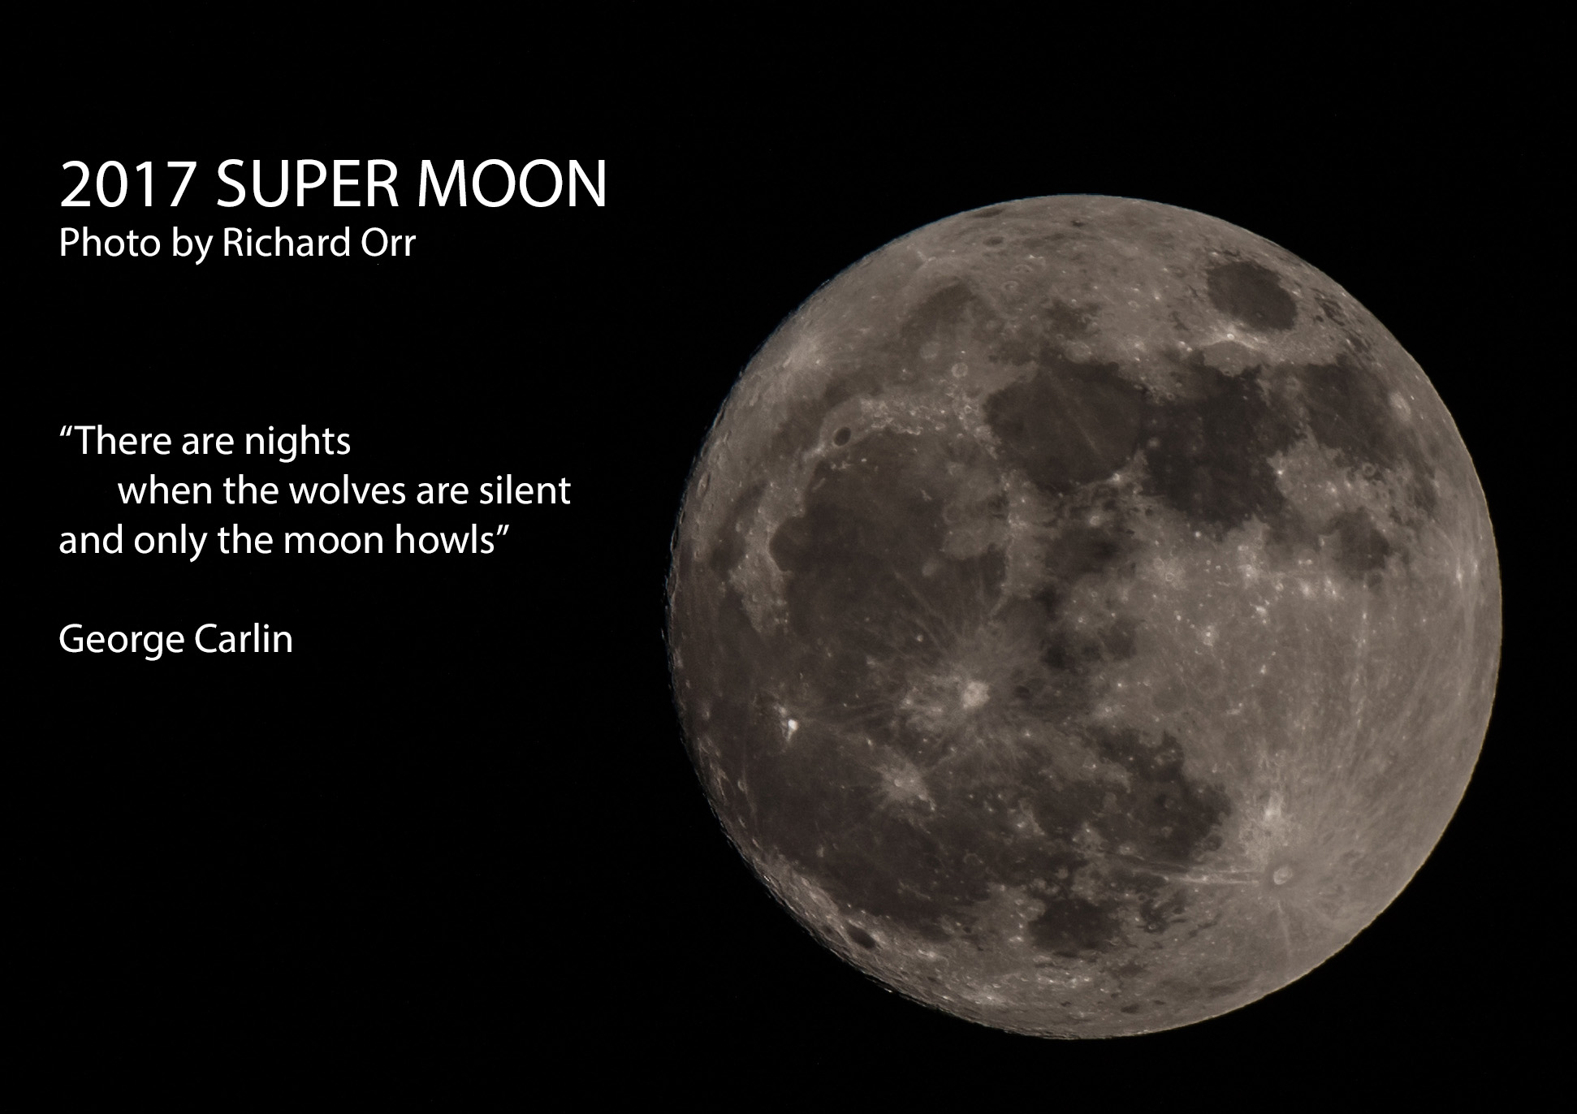

Slide 23
2018 HAL Election
Only one nominee for each of the six elected HAL Board positions:
President: Jim Johnson
1st VP: Mike Krauss
2nd VP: Bob Dutilly
Secretary: Paul Montanaro
Treasurer: Bob Savoy
Events Coordinator: David Stein
Entire Slate was Elected!

Slide 24
Election Wrap Up
2017 Board – Thank you!
2017 – 2018 Transitions
- David Stein replaces Joel Goodman as Events Coordinator
- Appointed positions (at 2/18 Planning Mtg)
- Joel Goodman replaces Chas Rimpo as Observatory Director
- Chas Rimpo stays on as Webmaster

Slide 25
President’s 2018 Priorities
Overarching Theme
Member input and involvement
Improve usability of HALO/Watson telescope
Continued emphasis on visual observing
Make progress in updating the HAL website
Grow the membership base

Slide 26
Thank You!
Next month’s meeting is on Thursday, February 15th, 2018 at 7 PM
Guest Speaker
Dr. Thomas S. Barclay
TESS Mission/Science Support Center

